Slide 1
Food Security And Conflict: Stabilisation Forces And Agricultural Awareness
Dr Richard Byrne
Rural Security Research Group
Harper Adams University

Slide 2
All opinions expressed in this presentation are my own and do not reflect that of any other organisation
Acknowledgements
Military Stabilisation
Support Group
Maj JPAD Davies (RW) MSSG

Slide 3
Overview
What is food security
Why should the military care about Impacts of food insecurity
Developing agricultural awareness
In practice
Issues

Slide 4
Defining Food security
Food security exists when all people, at all times, have physical and economic access to sufficient, safe and nutritious food that meets their dietary needs and food preferences for and active and healthy life
FAO (2006) defined World Food Summit 1996

Slide 5
Food Security Influences
Population
Land degradation
Urban expansion
Disease
Energy crops/ industrial crops
Climate change*
Conflict*
                *key focus

Slide 6
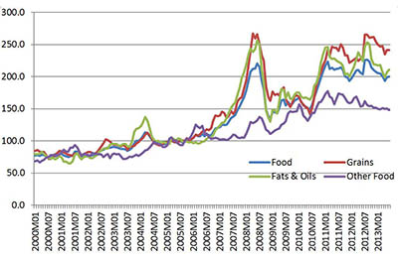
Increased volatility of food prices

Slide 7
Post 2008
48 Countries affected by food shortages
civil unrest
link - hunger and political instability
conflict - populations react with coping strategies impacts food consumption and nutrition

Slide 8
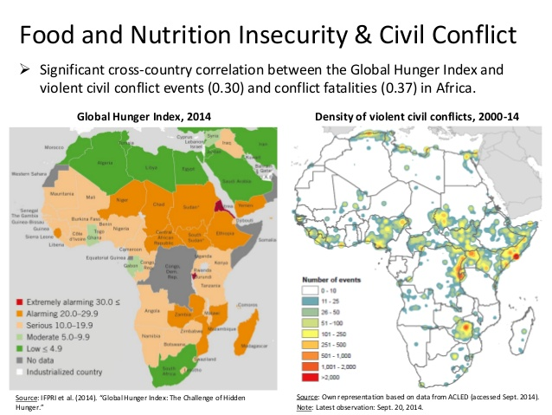

Slide 9
Four Dimensions of Food Security
Availability - production, supply, trade
Access - ability to buy or produce
Utilisation - being able to cook/ prepare
Stability - ability to access at all time, in all seasons

Slide 10
Disruption of food systems by conflict
Interruption of farming, herding activities
average drop in Africa 12%
Angola - 44%
Changes farmer behaviour - risk management
- farmers feed themselves first

Slide 11
Mozambique
60% reduction in dams and nursery facilities
80% loss of cattle
40% rural facilities destroyed - schools etc
loss of meteorological data, pest data
loss of seed stock

Slide 12
Stabilisation and Agriculture
Afghanistan
US Agri-Business Development Teams (ADTs)
Task specific
ID need for more general information

Slide 13
The imperative to understand
Why agriculture matters;
Boko Haram/ Al – Shabaab (socio-economic cohesion and influence)
Ebola (comprehensive approach)
Climate change (security)

Slide 14
Adding to the skill set
Civil Affairs- CIMIC
Cultural awareness training
Operator personality key – ‘can do’
Baseline survey – ‘expeditionary economics’

Slide 15
Not turning soldiers into;
Farmers
Farm advisors
Agricultural business experts

Slide 16
Providing Stabilisation Forces with a framework to;
understand rural socio-economic, security and geographical interactions and issues affecting ability to maintain livelihoods

Slide 17
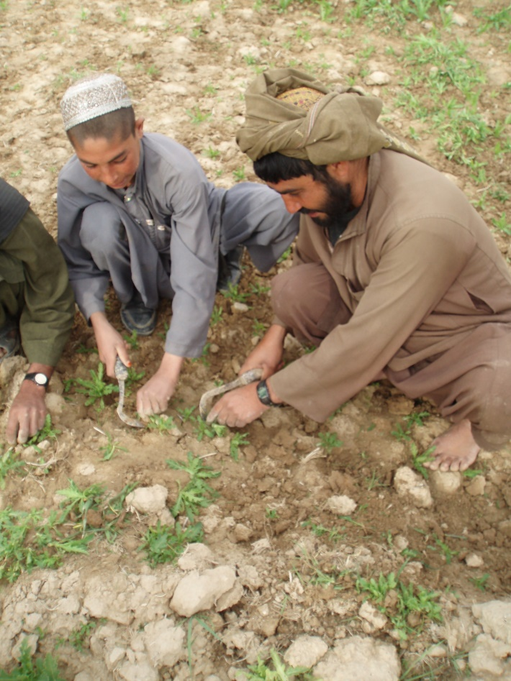
Survey Methods
RRA (Rapid Rural Appraisal)
What, When, How and Who
$
Gender

Slide 18
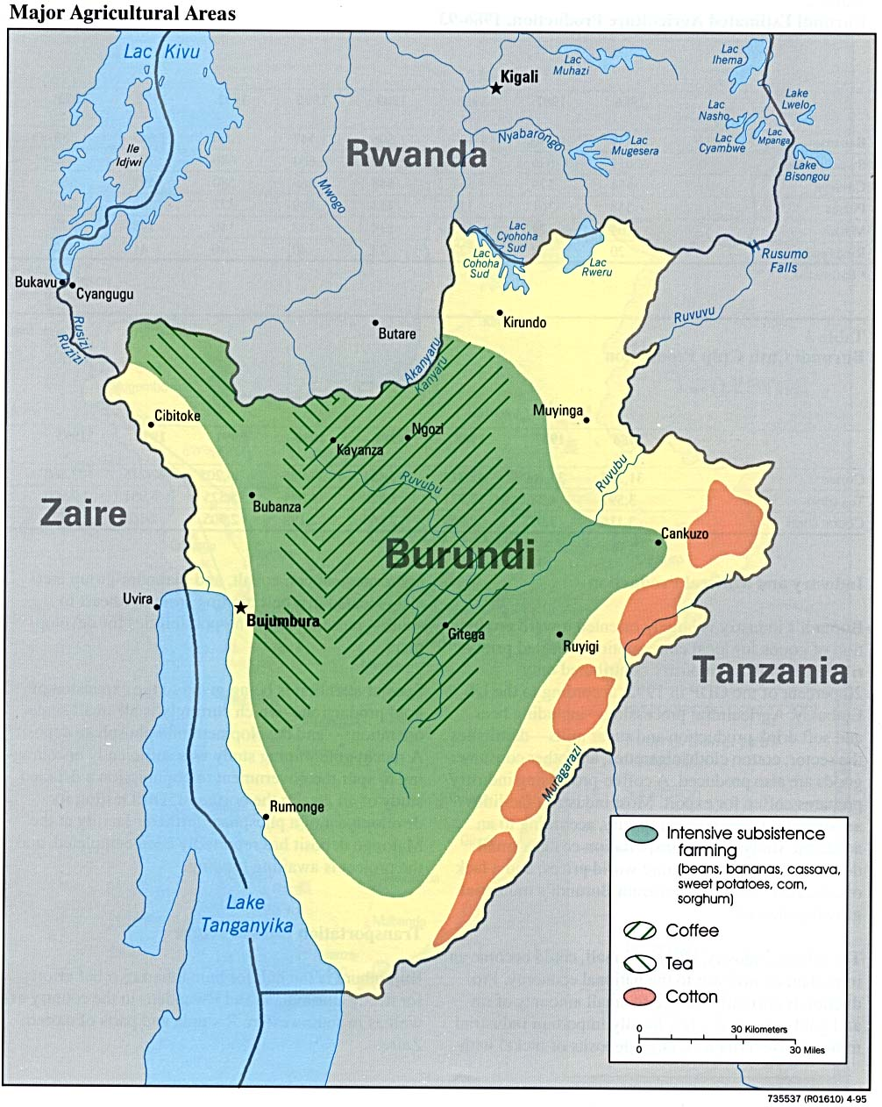
Burundi Pilot

Slide 19
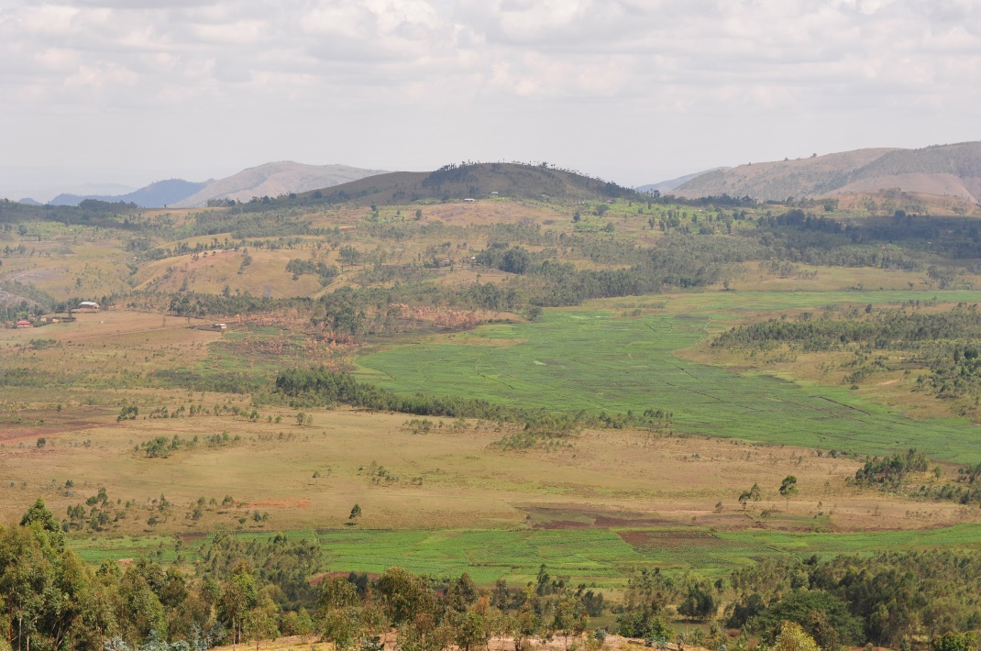
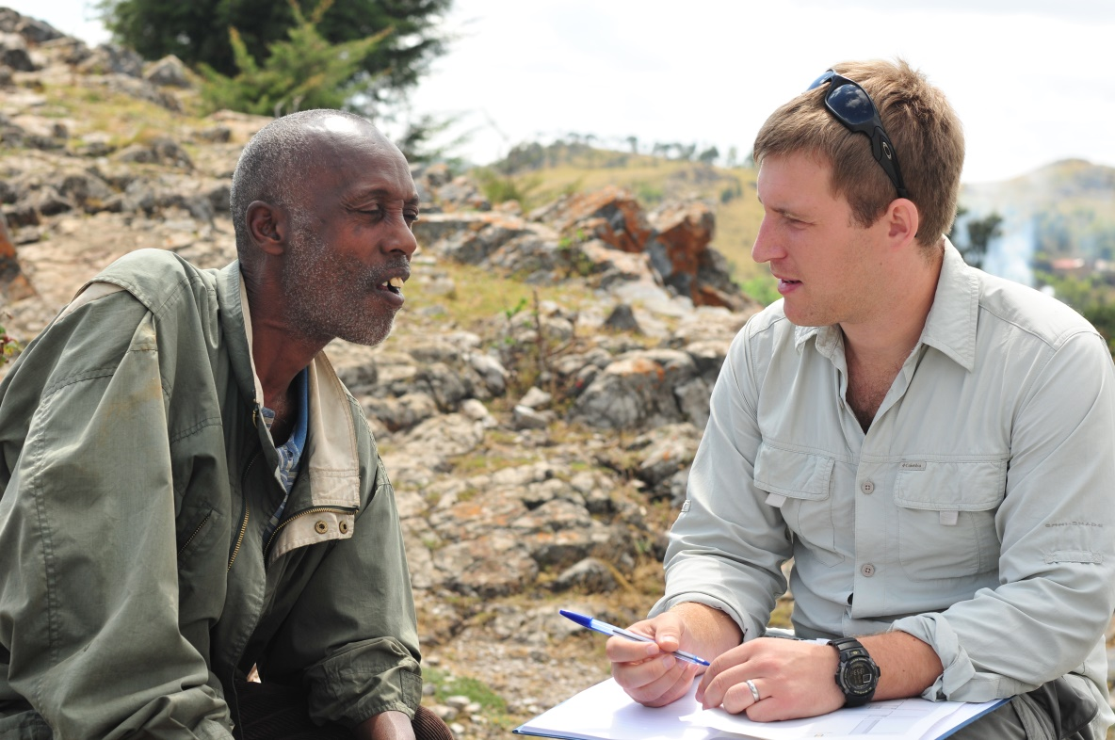
Burundi Pilot

Slide 20
Outcomes
Identified;
Lack of fertilizer
Crop pests
Gender issues – access to markets (security)

Slide 21
Reach Back
Feeding information into;
Civ-Mil planning (main client)
Academia
NGOs
IOs

Slide 22
Issues
Blurred lines- CIMIC activity NOT aid
Personnel skill set
Personnel rotations
Need to maintain data as ‘Unclassified’
How to get data out there

Slide 23
Dr Richard Byrne
Rural Security Research Group,
Land, Farm and Agri-Business Development,
Harper Adams University
Shropshire, TF10-8NB
rbyrne@harper-adams.ac.uk @UKruralsecurity

