Slide 1
SECURITY, CONFLICT AND INTERNATIONAL DEVELOPMENT (SCID) PROGRAMME
HOLISTIC SECURITY – A PRACTITIONER’S PERSPECTIVE by
PHILIP WILKINSON OBE, MPHIL, MRSAWS, MCGLI

Slide 2
HOLISTIC SECURITY – A PRACTITIONER’S PERSPECTIVE
OBSERVATIONS FROM:
Malaya – counter-insurgency;
Dhofar/Oman – counter-insurgency;
Northern Ireland – police work;
Bosnia – Peace Support Operations;
Afghanistan – security sector reform and counter-insurgency;
Iraq - security sector reform and counter-insurgency.

Slide 3
HOLISTIC SECURITY – A PRACTITIONER’S PERSPECTIVE
Apart from the intellectual void that was the Global War on Terror – the GWOT – treating security holistically, at least at the strategic level has been the historic norm.

Slide 4
MY FORMULATIVE MILITARY EXPERIENCE IN MALAYA AND SINGAPORE 1970-71
Based on the understanding that at the strategic level counter-insurgency was a profoundly political affair requiring political leadership and that at the tactical level success was dependent upon a policy of ‘hearts and minds’ to win over the indigenous peoples. Hearts and minds were not to be solely the preserve of the military but required a coordinated social, economic and security plan supported by a dynamic Public Relations strategy to counter the insurgent’s propaganda campaign. Under-pinning COIN in the draw down from Empire was an acknowledgement of the need to build the indigenous capacity to govern themselves and therefore to transition international support programs to local ownership.
All equally relevant today
Sir Robert Thompson, Defeating Communist Insurgency: The Lessons of Malaya and Vietnam (New York: Frederick A. Praeger, 1966).

Slide 5
DHOFAR COUNTER-INSURGENCY 1966-76
‘The aim was not to obliterate the enemy but to persuade them to join the government’s side. It was first and last a war about people, a war in which both sides concentrated upon winning the support of the civilians of the Jebel Dhofar and which was won in the end by civil development. Military action was merely a means to that end’.
and,
‘Two things were clear: first, that the answer to the insurgency lay in civil development, and second, that the answer had to be found by the Omanis themselves.’
Jeapes Tony, SAS Secret War Operation Storm in the Middle East, 2005 Greenhall Books.

Slide 6
TACTICAL LESSONS FROM DHOFAR
NO COLLATERAL DAMAGE;
IMPORTANCE OF INTERPRETERS AND HAVING VETERINARY TRAINED SOLDIERS ON EVERY PATROL;
NO MENTION OF SURRENDER AND TO TREAT ALL PRIONERS WITH RESPECT – PRISONERS HAD BEEN MISLED THEY WERE NOT INHERENTLY WICKED.

Slide 7
OBSERVATIONS AND LESSONS FROM NORTHERN IRELAND
IMPORTANCE OF IMPARTIALITY, RESTRAINT AND THE NEED FOR A COORDINATED PLAN FOR INTER-COMMUNAL RECONCILIATION TO OVERCOME THE CHALLENGES OF CENTURIES OF PREJUDICE AND CONFLICT;
ADVANTAGES OF POLICE PRIMACY AND COMMUNITY POLICING;
IMPORTANCE OF GOOD INTELLIGENCE IN SUPPORT OF THE RULE OF LAW AND POLITICAL (PEACE) PROCESS
THE IMPORTANCE OF RULE OF LAW AND EQUAL ACCESS TO JUSTICE.

Slide 8
PEACE SUPPORT OPERATIONS: DEFINITIONS:
PSO are multi-functional operations conducted impartially involving military forces and diplomatic and humanitarian agencies and are designed to achieve a long term political settlement. PSO include peacekeeping, peace enforcement as well as conflict prevention, peace-making, peace building and humanitarian operations. PSO are generally in support of a UN or OSCE mandate.
And,
PSO are designed to conclude conflict by conciliation among the competing parties, rather than a short term and superficial termination of the conflict by force. Military activities in PSO are designed to create the conditions in which other diplomatic and humanitarian agencies are more able to redress the symptoms and underlying causes of the conflict and thus achieve long term political settlement. A stable settlement not military victory is the ultimate measure of success in PSO.
Joint Warfare Publication 1999 3-50 Peace Support Operations, 1999.

Slide 9
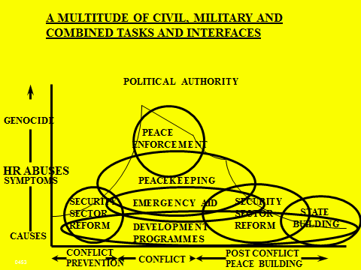

Slide 10
Security Sector Reform at the National Level
A National Security Review of available ends, ways and means
including a
Comprehensive National Threat and Risk Assessment
Leading to
A National Security Policy/Strategy Statement
that defines missions, roles, responsibilities and coordinating mechanisms within the national fiscal round.

Slide 11
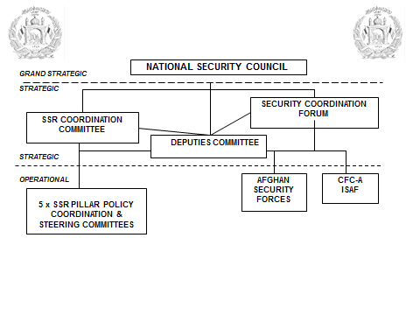

Slide 12
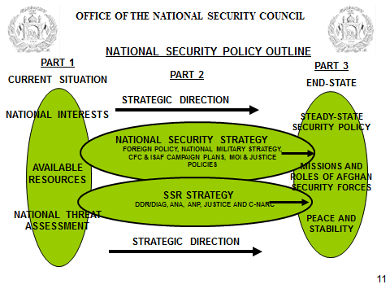
AFGHAN NATIONAL DEVELOPMENT STRATEGY

Slide 13
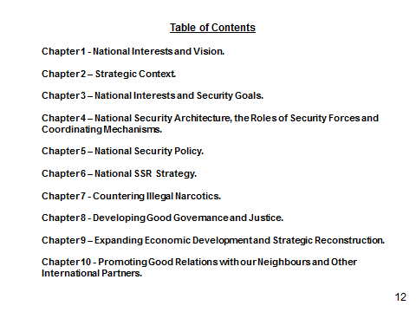

Slide 14
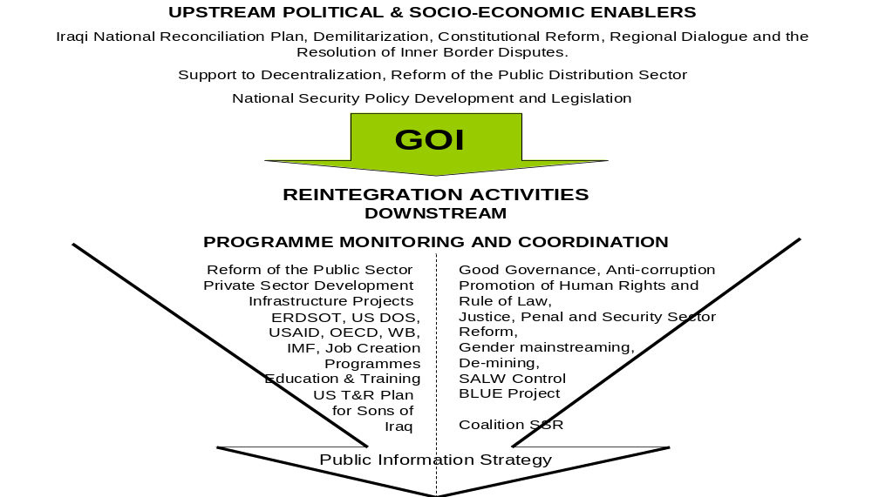
SUSTAINABLE EMPLOYMENT
RULE OF LAW
POVERTY REDUCTION
SOCIAL AND ECONOMIC DEVELOPMENT
MILLENIUM DEVELOPMENT GOALS

Slide 15
SECURITY POLICY DEVELOPMENT PROCESS - 2008
Step 1. A statement of the democratic principles under-pinning the review.
Step 2. Identify stakeholders and establish an inclusive and transparent NSP development process that includes civil society and citizens.
Step 3. Identification of vital national interests, not just in terms of traditional foreign and defence policy objectives but also others such as the need for reconciliation of different ethnic and religious groups. The Iraqi national development strategy should essentially set not only the context but also the goals of a NSP. In the longer-term the ultimate objective of every country, rich or poor should be the achievement of the UN’s millennium development goals.
Step 4. Conduct a comprehensive national threat assessment to national interests identified in National Development Strategy.
Step 5. Assessment of the existing security sector, its strengths and weaknesses, and its ability to reconfigure and retrain for new roles and missions.
Step 6. Development and agreement of basic security assumptions.
Step 7. Definition of security requirements.
Step 8. Definition and delineation of missions, roles and responsibilities to the various elements of the security sector.
Step 9. Establish national security budget and allocate resources.
Step 10. Force development and capacity building.
Step11. Develop finance, pay, procurement and personnel policies; conduct a training needs analysis leading to institutional development.
Step12. Promulgate NSP and relevant legislation.
Step13. Establish a review and process for identifying and learning lessons.

Slide 16
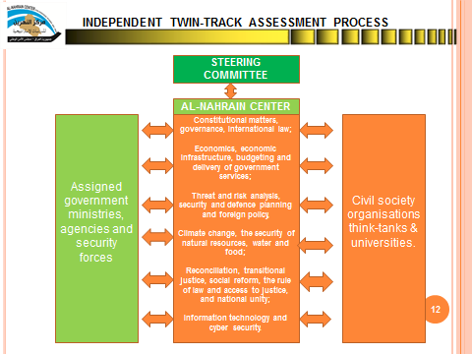

Slide 17
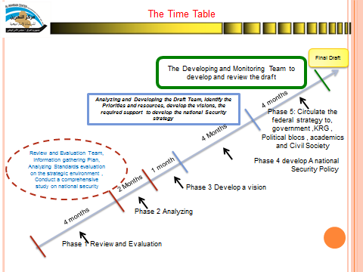

Slide 18
HOLISTIC SECURITY – A PRACTITIONER’S PERSPECTIVE
LESSONS
If you ever think you are coming close to understanding the complex challenge of holistic security you will be proven wrong. There are too many unknowns to even think about developing template concepts.
When the central government is ineffective and does not have a monopoly of force, criminality, corruption and impunity will be an inescapable fact of life that will negatively affect the best laid plans.
From a recipient government perspective, international support will usually be anarchic. Donor governments, aid and development agencies, UN and other will rarely if ever coordinate if it requires the subordination of their own agendas. to the greater good.
Holistic security is multi-everything and in the field the dynamics between conflict, security and development will change on a daily basis in different parts of the country and will be interpreted differently depending on where you stand on various issues.
But none of the above means that we should not seek a better understanding of the concept and condition of holistic security as it is the holy grail.

Slide 19
QUESTIONS

