Slide 1

Conflict Assessments &
Application in Adaptive Conflict Programme Management
Matthew Waterfield
University of Leicester
13 March 2014

Slide 2

Conducting Conflict Assessments and Application in Adaptive Conflict Programme Management
Contents
Approaches to conflict analysis
Adaptive conflict programme management
Resources

Slide 3
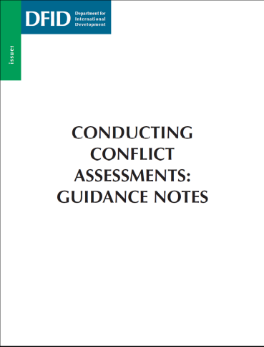
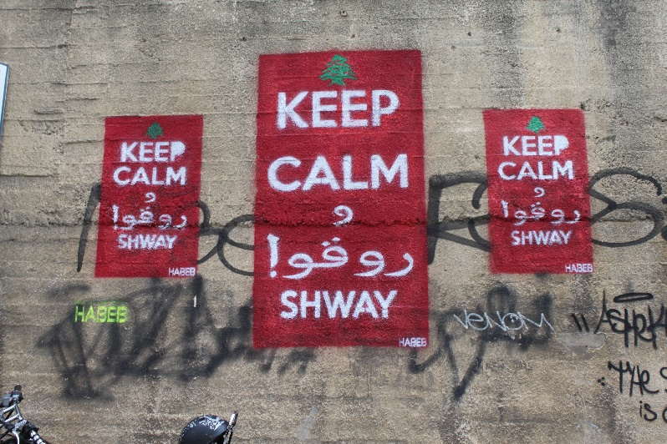
Traditional Approaches to Conflict Assessments
Conducting Conflict Assessments and Application in Adaptive Conflict Programme Management
Linear
Tackle root causes
Mitigate spoilers
Causes
Consequences

Slide 4
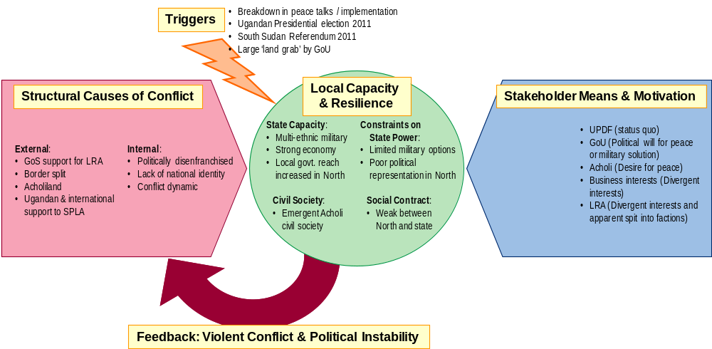
Prime Minister’s Office – Countries at Risk of Instability
Conducting Conflict Assessments and Application in Adaptive Conflict Programme Management

Slide 5
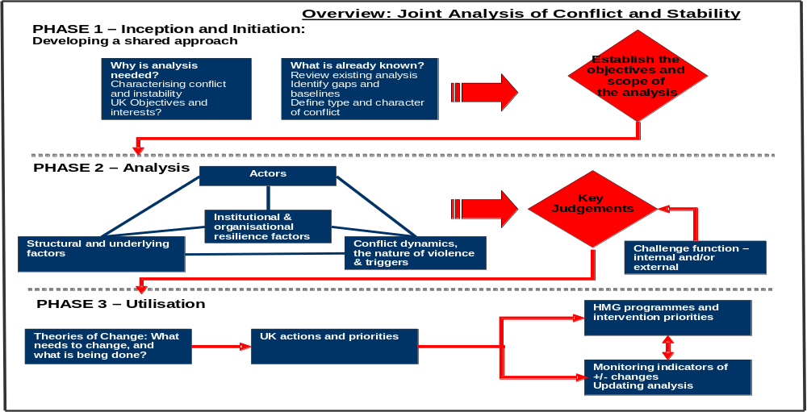
Joint Analysis of Conflict and Stability (JACS)
Conducting Conflict Assessments and Application in Adaptive Conflict Programme Management

Slide 6
Conducting Conflict Assessments and Application in Adaptive Conflict Programme Management
Contents
Approaches to conflict analysis
Adaptive conflict programme management
Resources

Slide 7
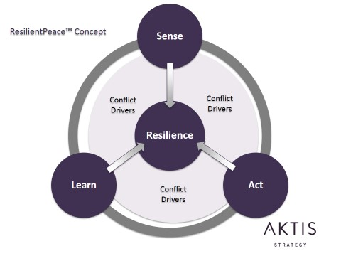
Conducting Conflict Assessments and Application in Adaptive Conflict Programme Management
Resilient Peace

Slide 8
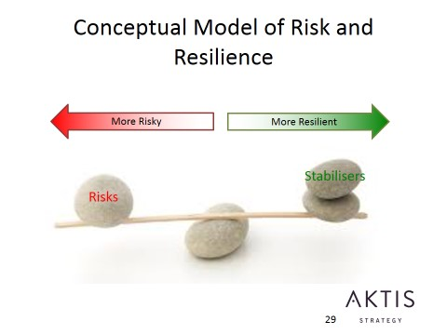
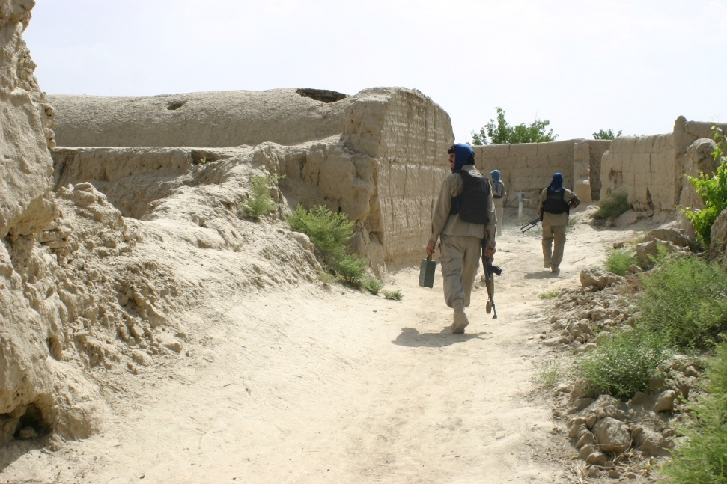
Conducting Conflict Assessments and Application in Adaptive Conflict Programme Management
Resilient Peace

Slide 9
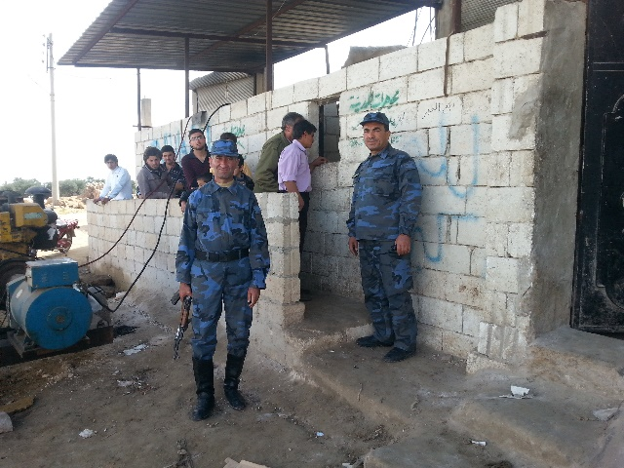
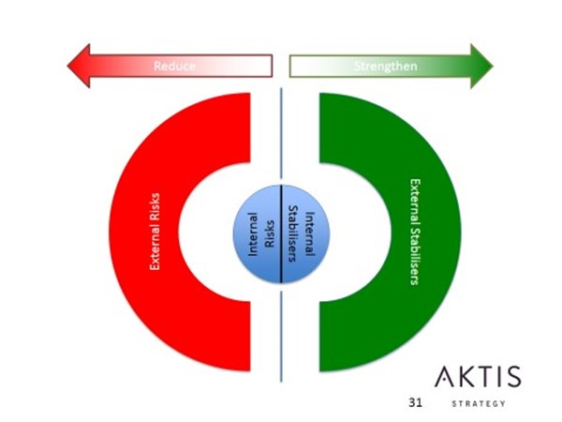
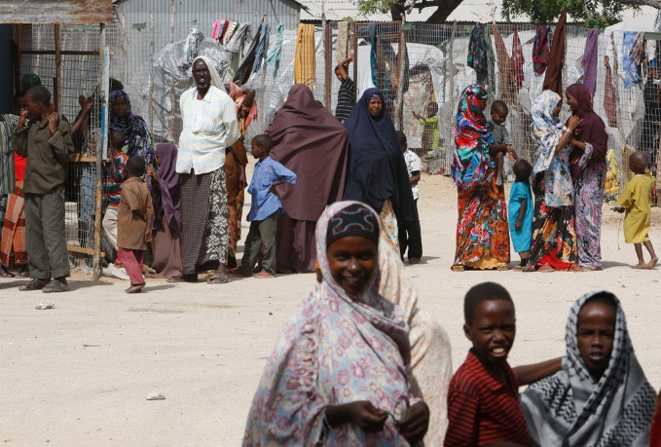
Conducting Conflict Assessments and Application in Adaptive Conflict Programme Management
Resilient Peace

Slide 10
Conducting Conflict Assessments and Application in Adaptive Conflict Programme Management
Contents
Approaches to conflict analysis
Adaptive conflict programme management
Resources and discussion

Slide 11
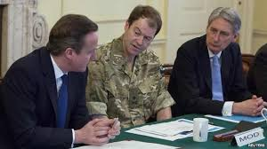



Conducting Conflict Assessments and Application in Adaptive Conflict Programme Management
Resources and discussion
PCNA: www.undg.org/content/post-crisis_transition/post-conflict_needs_assessments_(pcna)
Conflict Sensitivity: www.conflictsensitivity.org
Updates on conflict analysis: www.conflictanalysis.org
World Bank conflict analysis: http://web.worldbank.org/WBSITE/EXTERNAL/TOPICS/EXTSOCIALDEVELOPMENT/EXTCPR/0,,contentMDK:20486708~menuPK:1260893~pagePK:148956~piPK:216618~theSitePK:407740,00.html

